Slide 1

Sam Khoza
ICT Director
ITSIUG 2025

Slide 2


Topic
Threats to Trust: Enhancing Cybersecurity Resilience at the University of Venda
Cybersecurity refers to the practice of protecting systems, networks, and programs from digital attacks.
For universities, cybersecurity is essential to safeguard sensitive information, ensure the continuity of academic activities, and maintain the trust of students, staff, and stakeholders.
Univen has adopted the ZERO TRUST model - a new network security approach that assumes no user or device can be trusted by default.

Slide 3

Digital Transformation in Higher Education
Digital transformation involves integrating digital technologies into all aspects of an institution’s operations:
  enhancing educational delivery,
  administrative processes,
  and student engagement.
  Etc.
Key trends include the adoption of:
  cloud computing,
  online learning platforms,
  and data analytics.
  Etc.
These advancements offer significant benefits but also introduce new cybersecurity challenges.

Slide 4
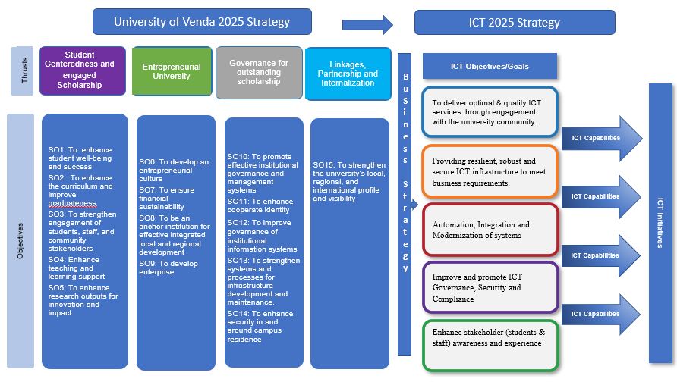

Univen Digital/ICT Strategy 2021-2025

Slide 5
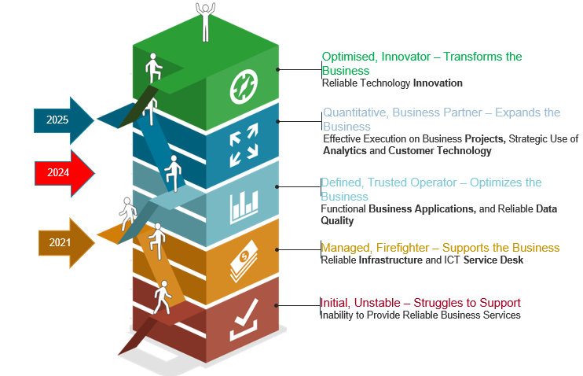
ICT Governance Maturity Level (Current and Target State)
Univen Conducted a Governance Maturity and Penetration test in 2024.
5
4
3
2
1

Slide 6
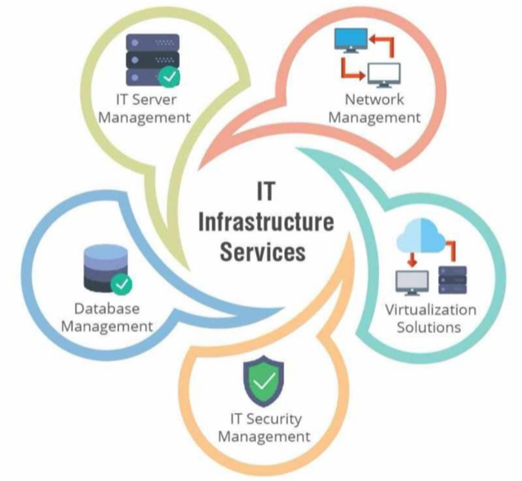
The Core ICT Infrastructure
Protecting the fundamental components of an Information and Communication Technology (ICT) system is crucial for ensuring the security and integrity of data and operations.

Slide 7

Migrate On-Premises Workloads to Azure
Moodle[2021]
Azure Domain Controller[2021]
ERDMS
Facial Recognition
BIS Labs
PMS [2022]
Celcat [2022]
Access Control [2022]
Webserver [2022]
ITS [2024]
Sysaid [2022]
Archibus[2022]
DSpace[2024]
HEDA[2024]
Sierra[2024]
IDU[2024]
UIGC[2021]
Ishmael Mohammed[2023]
AI and Machine Learning
SaaS
IaaS
PaaS
On-premise ICT Infrastructure
Domain Controllers, Clearpass, DHCP, SCOM, Valpac, MIM, Jaws, ADconnect, ERDAS, Routers, Switches, Access Points, Wi-Fi Controllers, Firewalls, Storage, VoIP, Backup System, Veralab, Printing Solution etc.

Slide 8
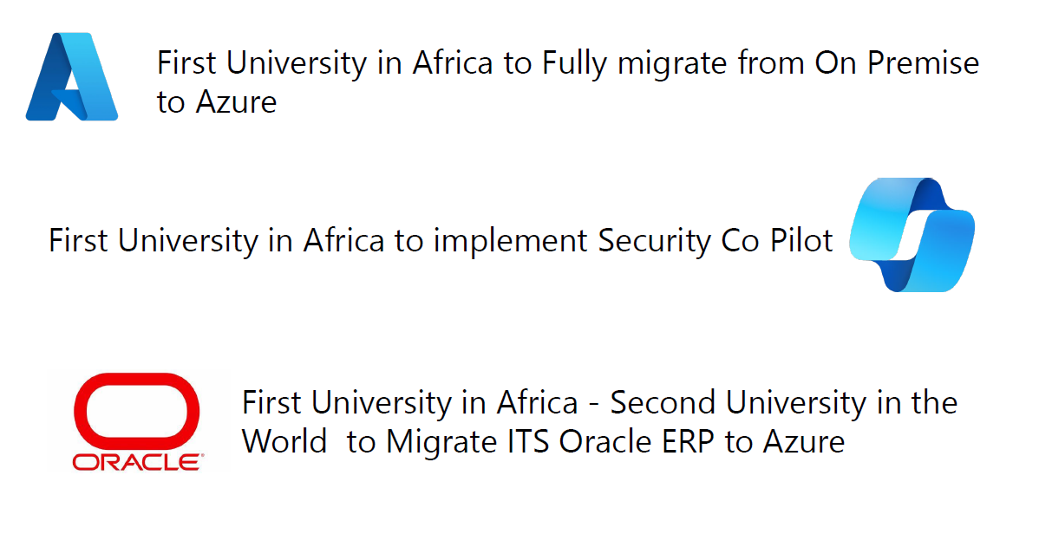
Univen Notable Achievements

Slide 9
Importance of Cybersecurity in Higher Education
Why Cybersecurity Matters
  Protection of sensitive data (student records, research data)
  Ensuring continuity of educational services
  Maintaining trust and reputation
Common Threats
  Phishing attacks
  Ransomware
  Data breaches
  Insider threats

Slide 10
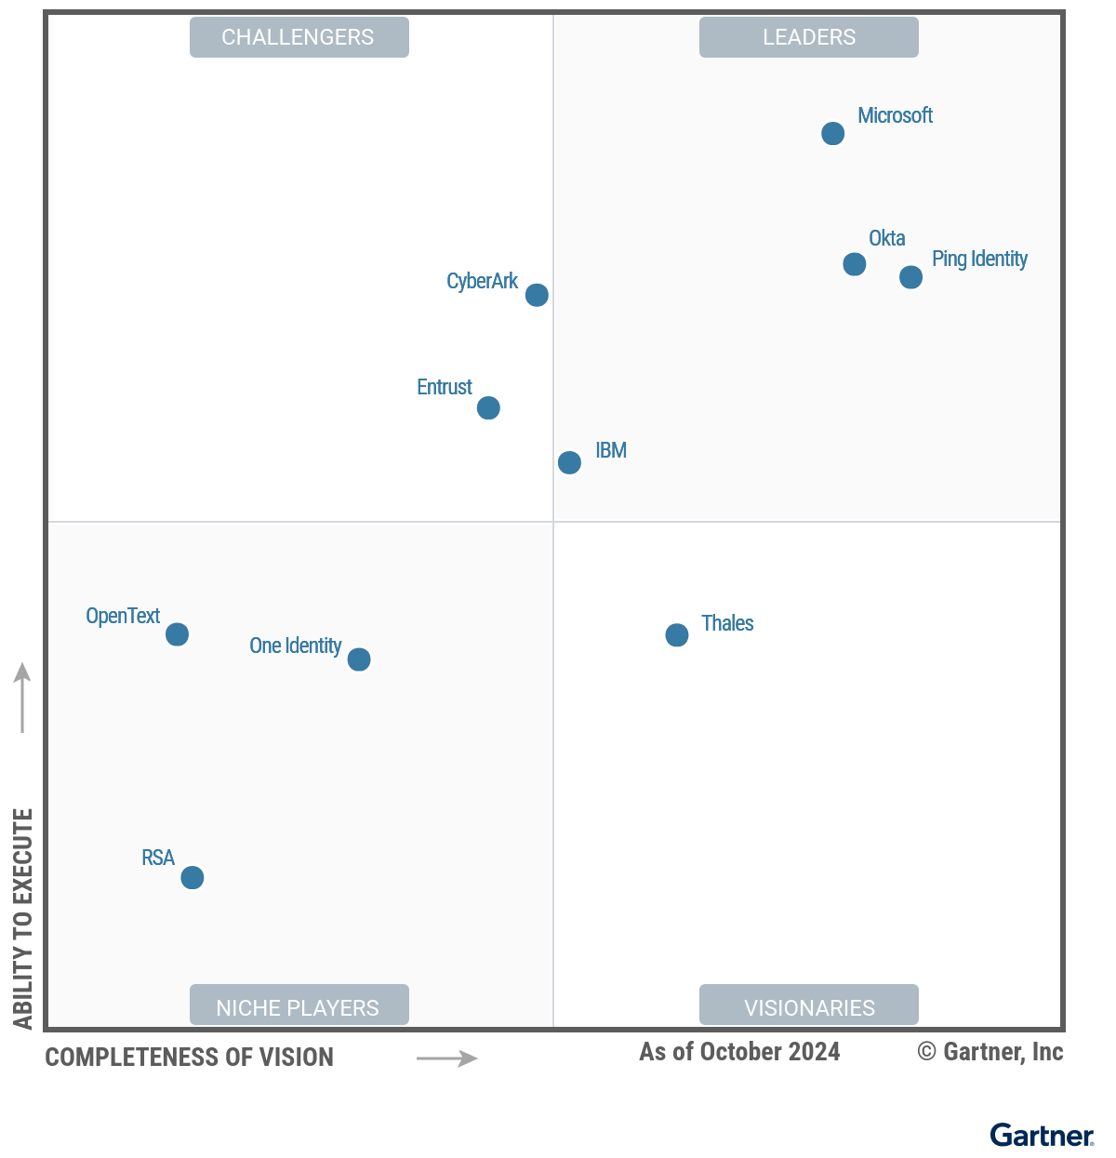
Magic Quadrant for Access Management

Slide 11
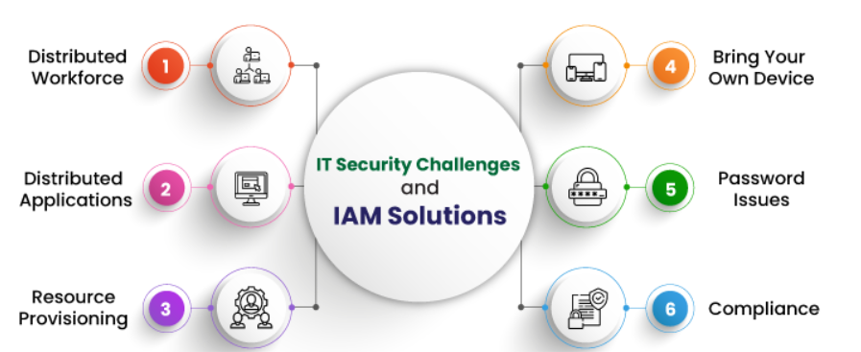
Emerging IT Security Challenges

Slide 12
University of Venda Cybersecurity Strategies
Preventive Measures
  Implementation of robust firewalls and antivirus software
  Regular security audits and vulnerability assessments
  Automated Patch Management
Detection and Response
  Intrusion detection systems
  Incident response plans
Awareness and Training (Building a Cybersecurity Culture)
  Regular training sessions for staff and students
  Collaboration with external cybersecurity experts
  Promoting best practices for cybersecurity
Policies and Procedures
  Clear guidelines on data handling and usage
  Enforcement of cybersecurity policies

Slide 13
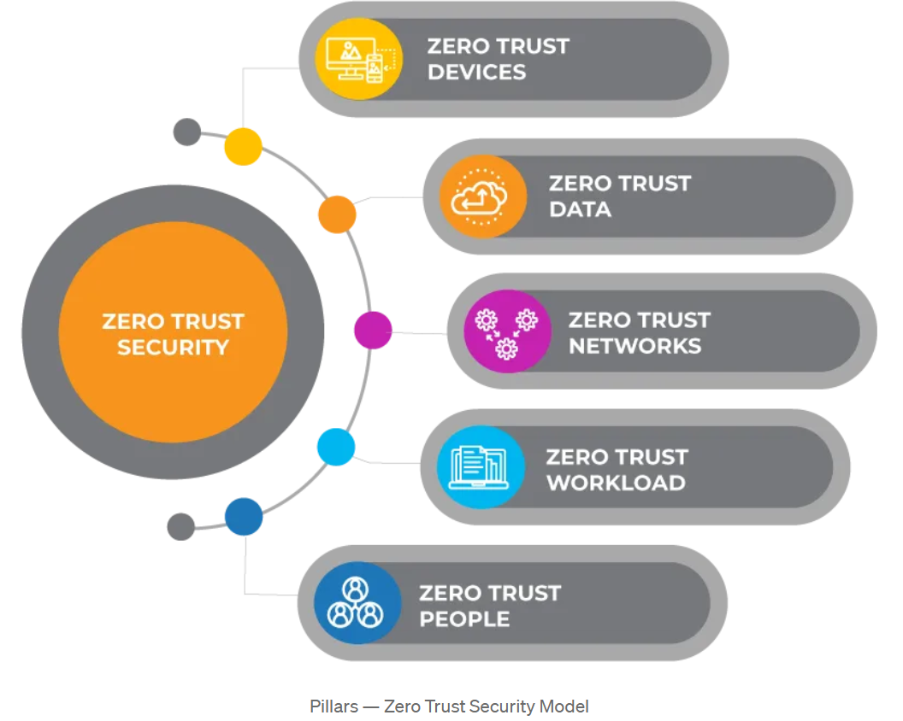
Zero Trust Approach
The adoption of cloud and mobile means that Univen no longer has a network perimeter-centric view of security.

Slide 14
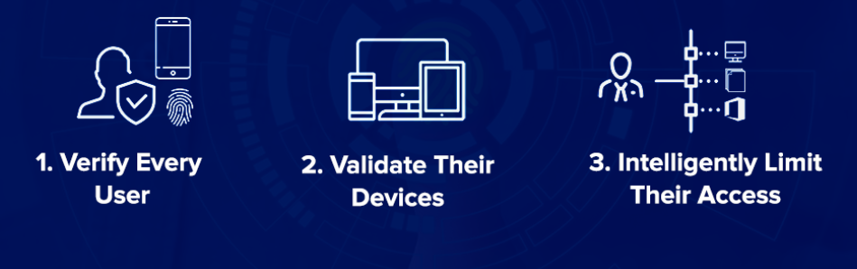
Zero Trust Security – Verify Model
The University of Venda is still offering (Remote) work-from-home to employees post-COVID-19.
The Zero Trust approach teaches us never to trust, always verify.

Slide 15
Univen Modernized Security
Our goal is to create a secure, resilient, and compliant digital environment at the University of Venda, where data is protected, access is controlled, and the community can confidently thrive in a trusted network.
Security and Identity Services Implemented:
  Microsoft Defender for Endpoint
  Microsoft Defender for Office 365
  Microsoft Defender for Identity
  Microsoft Defender for Cloud Apps
  Microsoft Defender for Cloud
  Microsoft Sentinel
  Microsoft Entra
  Microsoft Security Copilot
  PKI
  Multifactor Authentication
  Microsoft Intune
  Automated Patch Management

Slide 16
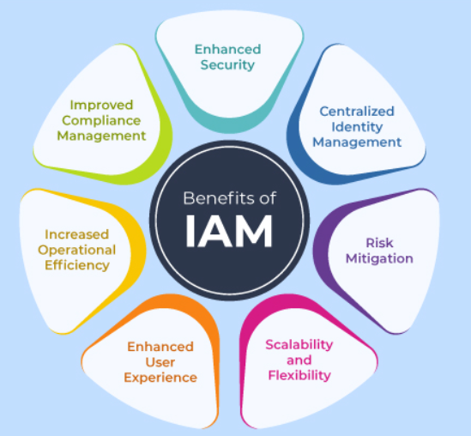
Benefits of IAM

Slide 17
Microsoft Security Co-Pilot
Univen is the first University in Africa to implement Security CoPilot.
Security Copilot is an AI-powered security solution that helps security teams protect Univen from cyber threats at machine speed and scale.
It works by using a large language model that can understand natural language queries and generate security-specific responses.
It also leverages the university's security expertise and global threat intelligence to provide tailored insights and recommendations.
Benefits to the University of Venda:
  Enhanced Security: Improved ability to detect and mitigate security threats swiftly, reducing the risk of data breaches.
  Real-time Monitoring: Continuous monitoring of university systems, ensuring faster response to potential vulnerabilities.
  Operational Efficiency: Automation of routine security tasks, freeing up IT staff to focus on more strategic initiatives.
  Data Protection: Stronger protection of sensitive academic and administrative data, ensuring compliance with privacy regulations.
  Cost-effective Security: Helps reduce the need for extensive manual interventions and lowers overall cybersecurity costs.

Slide 18
Network Security
Univen successfully deployed and integrated advanced security solutions into the University’s network infrastructure.
These solutions were implemented to ensure secure access, device compliance, and effective monitoring across wired and wireless networks.
Fortigate Firewalls
Aruba ClearPass – Network Access Control (NAC)
TACACS+ for Network Device Authentication
AirWave – Network Monitoring & Management
ClearPass Policy Manager (CPPM) – Advanced Access Control
Microsoft Intune – Endpoint Security & Compliance
FortiAnalyzer – Security Analytics & Log Management
FortiVPN SSO with Azure Integration

Slide 19
Conclusion
The University of Venda has adopted a Zero Trust approach.
2025 Security Projects:
  Rollout Passwordless Infrastructure - Microsoft Windows Hello for Business
  Onboarding Microsoft Purview
  Sentinel Optimization
  Enterprise Security Assessment
  Review Security Policies
  Network Penetration Test

Slide 20


THANK YOU

